Slide 1
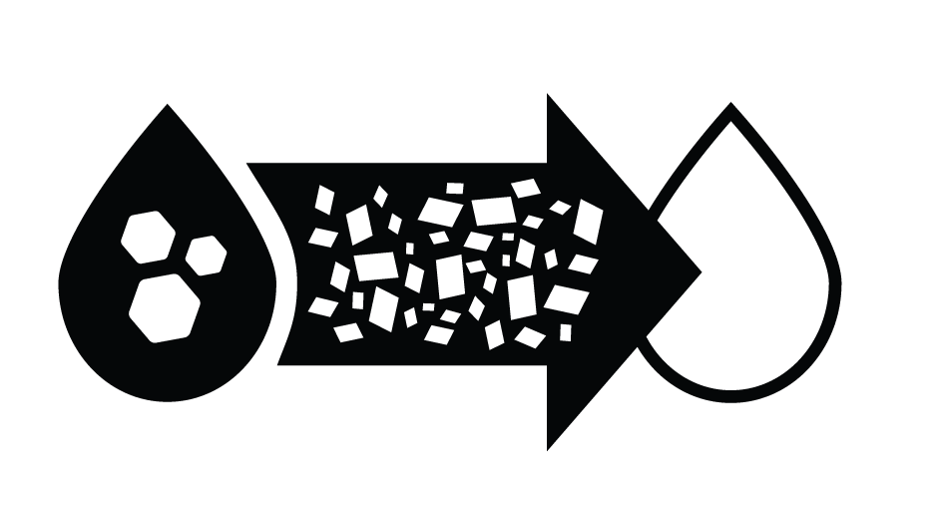
Bioreactor

Slide 2
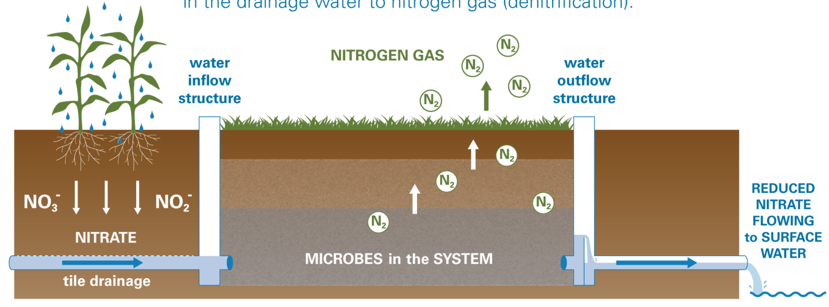
What Is a Bioreactor?
A bioreactor is a buried trench on the edge of a farm field that is traditionally filled with woodchips. Agricultural drainage tiles outlet into the woodchips where bacteria convert tile water nitrate-nitrogen into nitrogen gas.
Illustration credit: Iowa State University Extension and Outreach

Slide 3
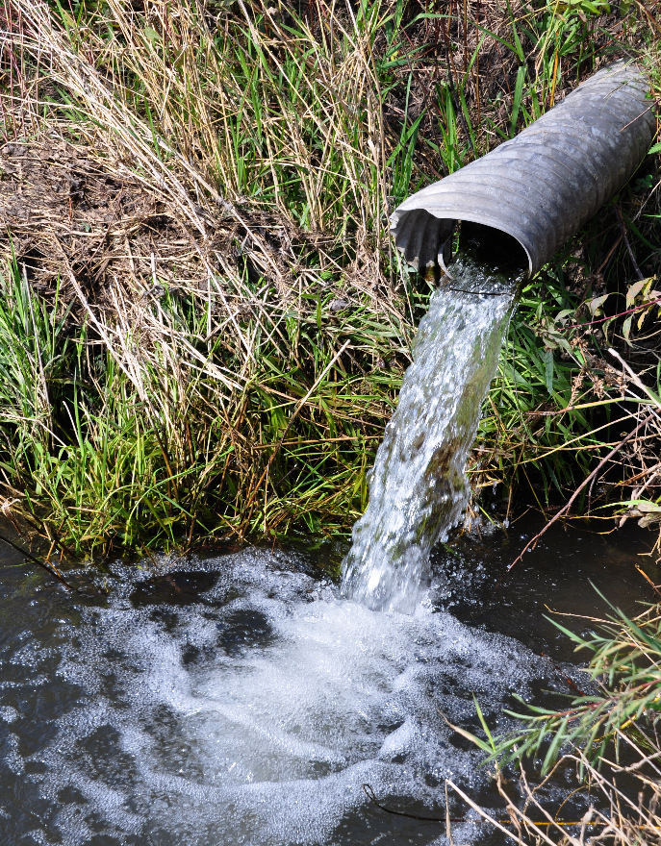
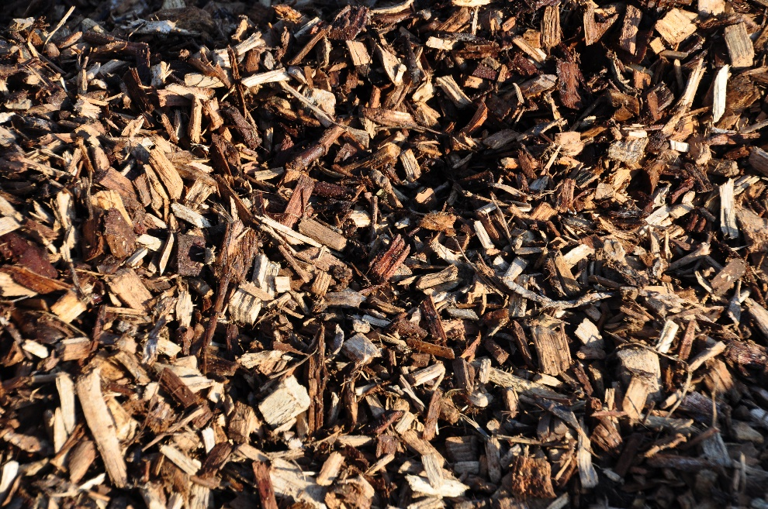
Why Use a Bioreactor?
Bioreactors are an edge of field practice, meaning that they do not impact in-field management.
Tile lines connect to a control structure, which allows water to flow into the woodchips. A second control structure assures that bacteria have enough time to remove nitrate-nitrogen, before water flows out of the bioreactor into a water body.
SWCS/IDALS photos by Lynn Betts.

Slide 4
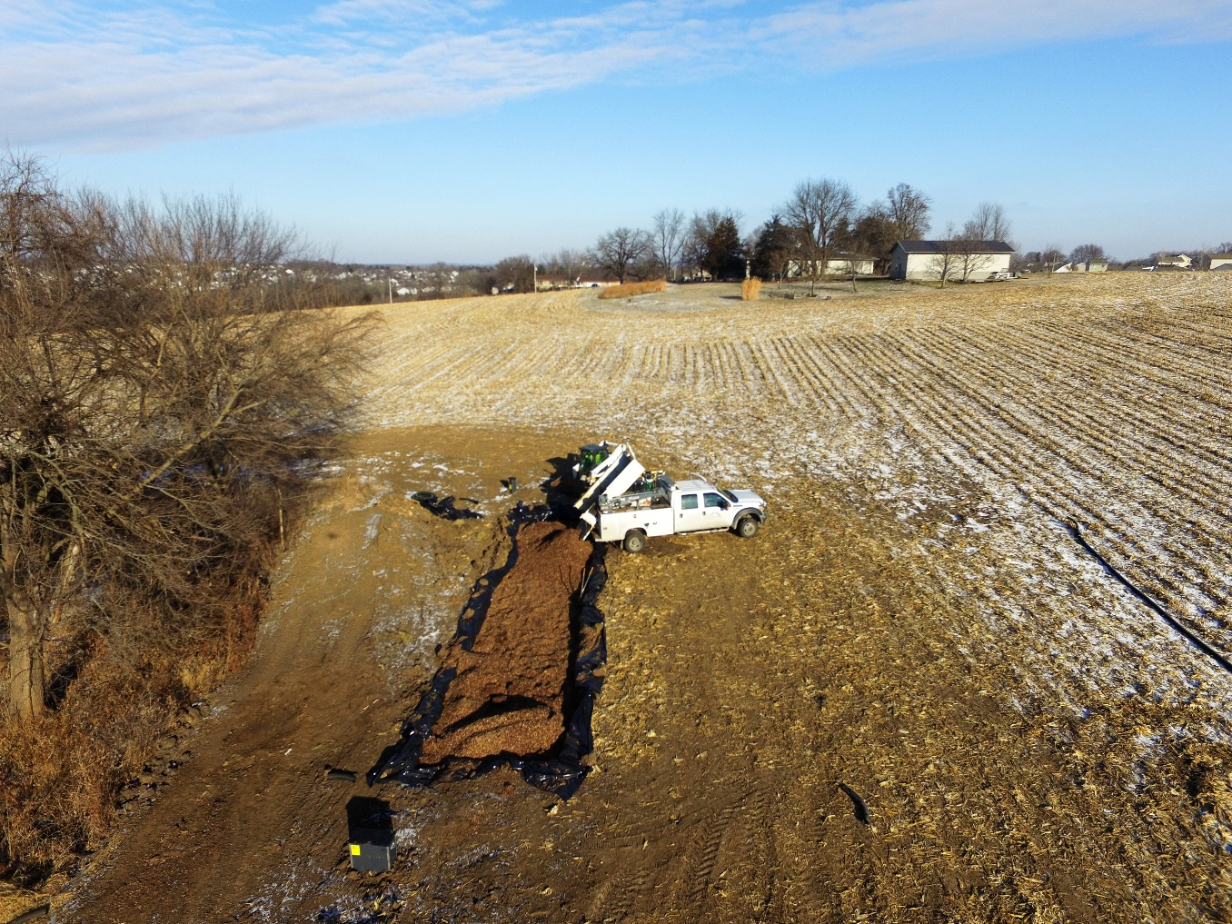
What Can a Bioreactor Do for Water Quality?
According to the Iowa Nutrient Reduction Strategy, a bioreactor, on average, removes 43% of nitrate-nitrogen from water diverted through it.
SWCS/IDALS photo by Lynn Betts

Slide 5
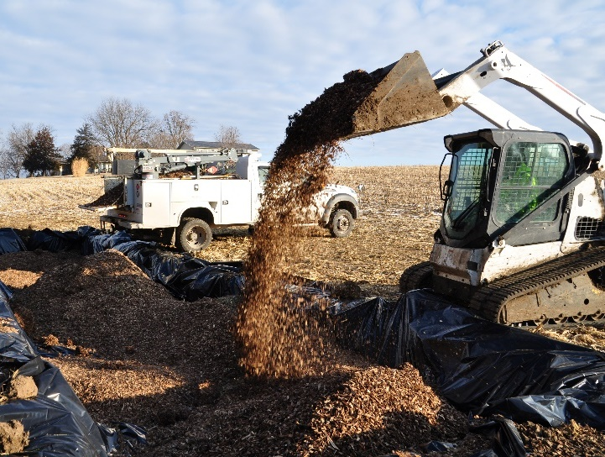
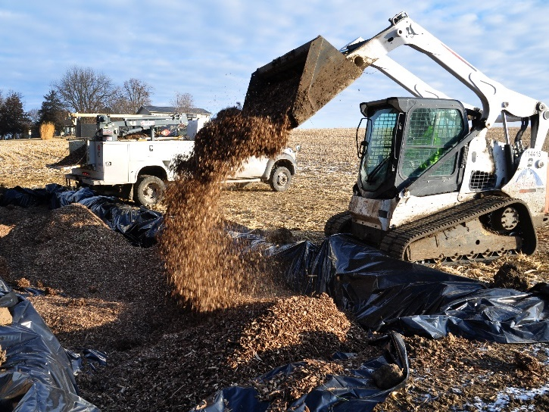
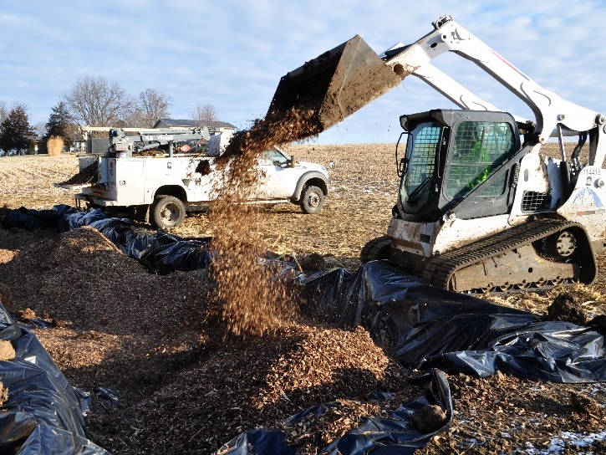
Benefits of a Bioreactor
Decreases nitrate-nitrogen being deposited in waterways
Does not impact in-field management, require little-to-no maintenance
Vegetation on top of the bioreactor can have habitat benefits
Have a lifespan of 10 – 15 before woodchips need to be replaced
SWCS/IDALS photos by Lynn Betts

Slide 6
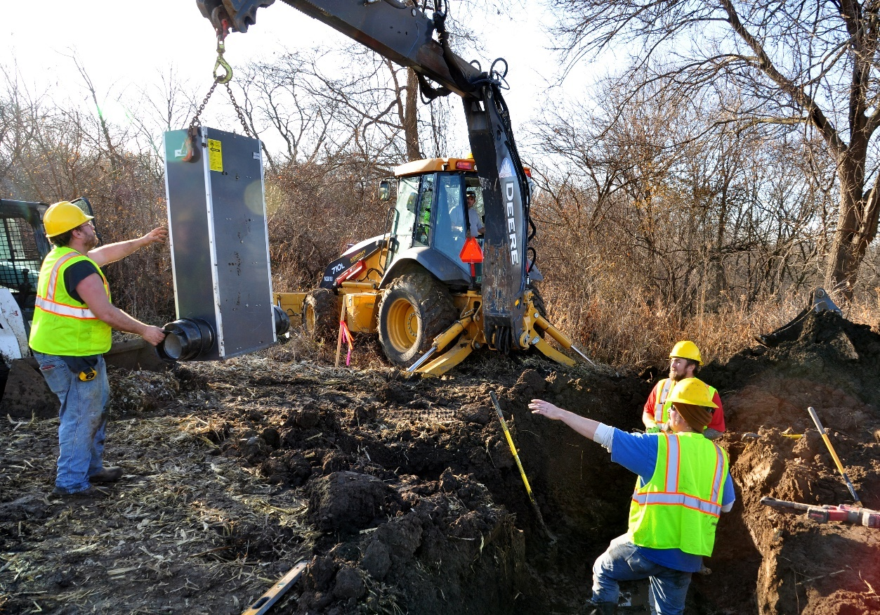
What Is the Cost of a Bioreactor?
The average cost of installation, equipment, woodchips and labor for a bioreactor is $15,000. However, it can vary greatly depending on the size of the bioreactor.
Compatible with existing federal (such as the NRCS’s EQIP funds) and state cost-share programs so farmers who implement them can recoup some of their costs.
Water control structure being installed in a bioreactor in Polk County, Iowa. SWCS/IDALS photo by Lynn Betts

Slide 7
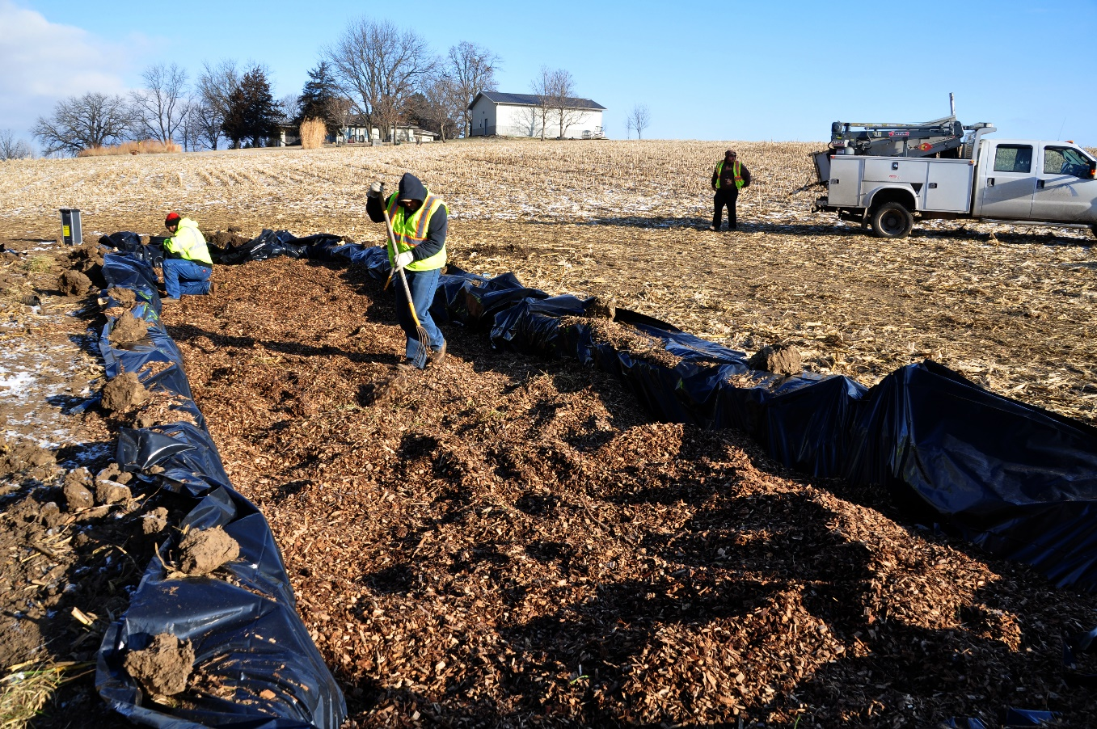
Bioreactors Work Best when…
The trench is:
Between 10 - 25 ft wide
Between 100 – 120 ft long
Filled with woodchips that are between ¼- to 1-inch in size range. Also avoid treated or preserved wood.
10-25 ft
100-120 ft.
SWCS/IDALS photo by Lynn Betts

Slide 8
Other Resources
https://www.flickr.com/photos/151012306@N08/albums/72157716968785063: A step by step visual guide to bioreactor implementation. These photos were taken on real farms across Iowa and are part of the Conservation Media Library.
https://www.cleanwateriowa.org/bioreactor: Several resources, including videos, from the Iowa Department of Agriculture and Land Stewardship’s Water Quality Initiative.
https://engineering.purdue.edu/watersheds/conservationdrainage/bioreactors.html: A storing house of resources from Purdue University
https://store.extension.iastate.edu/product/14530: Two-page factsheet on bioreactors from Iowa State University Extension and Outreach.
https://www.iowaagwateralliance.com/resourcelibrary/practices/bioreactors : Various technical and communication resources from the Iowa Ag Water Alliance.
https://store.extension.iastate.edu/product/15823: A whole farm conservation best management practices manual from Iowa State University Extension and Outreach. It includes a decision tree to help decide which edge of field practice is right for you.

Slide 9
This presentation is part of the Conservation Media Library. To learn more about it and access other resources, go to www.swcs.org. The addition of bioreactors to the Library was supported by a grant from the Iowa Department of Agriculture and Land Stewardship to the Soil and Water Conservation Society and Conservation Districts of Iowa.

