Slide 2
Our mission is to foster the science and art of natural resource conservation.
When you join SWCS, you join a community of conservation professionals who care about the future of natural resources. Our members engage in important conversations about soil and water, support the sustainability of our working landscapes, and serve as conservation leaders.

Slide 3
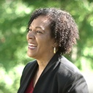
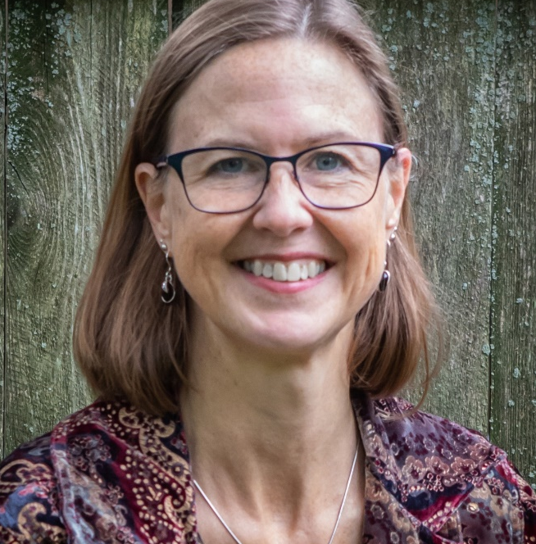
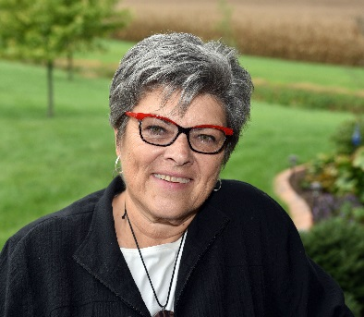
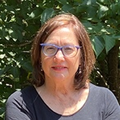
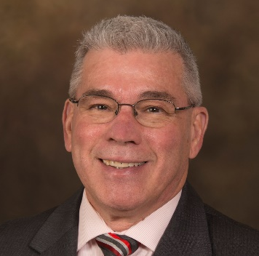
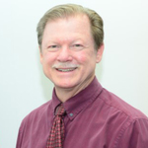
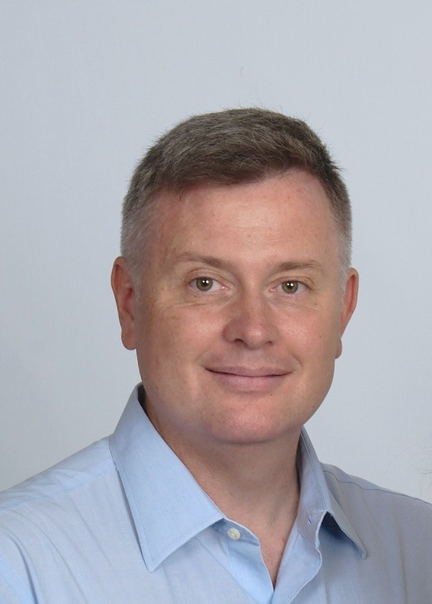
Our Board of Directors
Dale Threatt-Taylor, Chair Southeast Region Director
Rebecca Power, Vice-Chair North Central Region Director
Jane Hardisty, Secretary At-Large Director
Ellen Gilinsky At-Large Director
Keith Berns Northwest Regional Director
Jerry Hatfield At-Large Director
Steve Kadas, Treasurer Southwest Regional Director
Jason Weller At-Large Director
Chris Hartley Northeast Regional Director

Slide 4
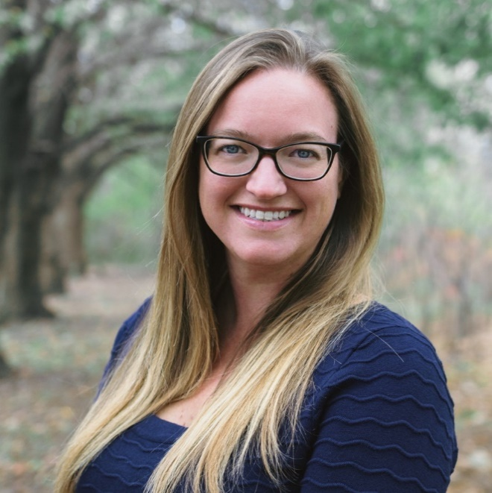
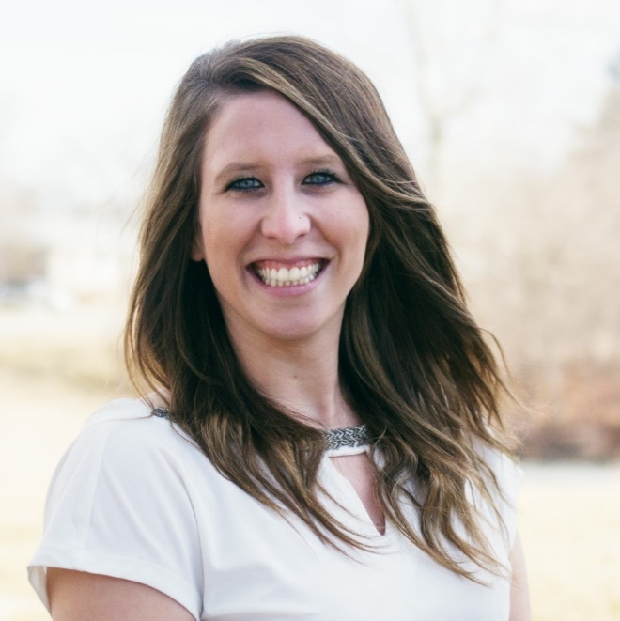
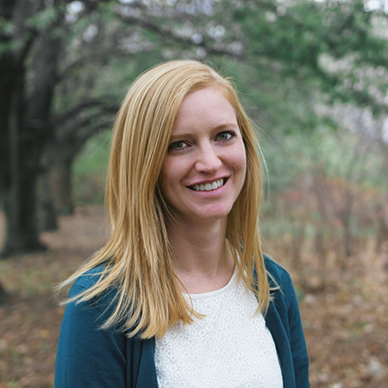
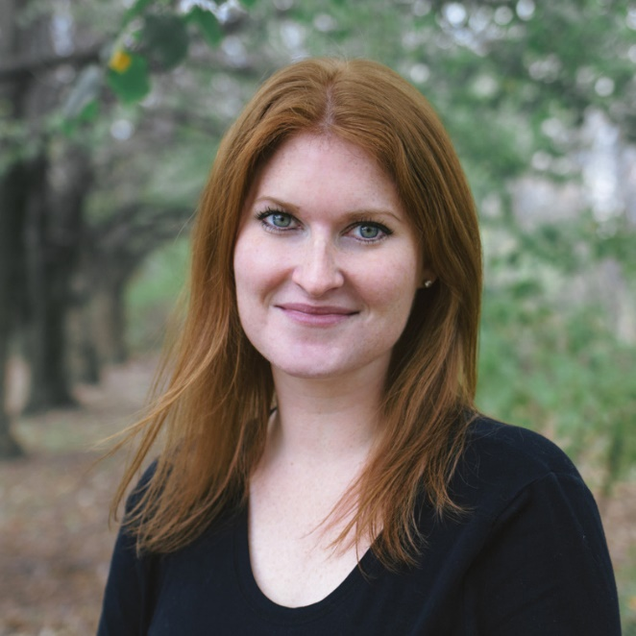
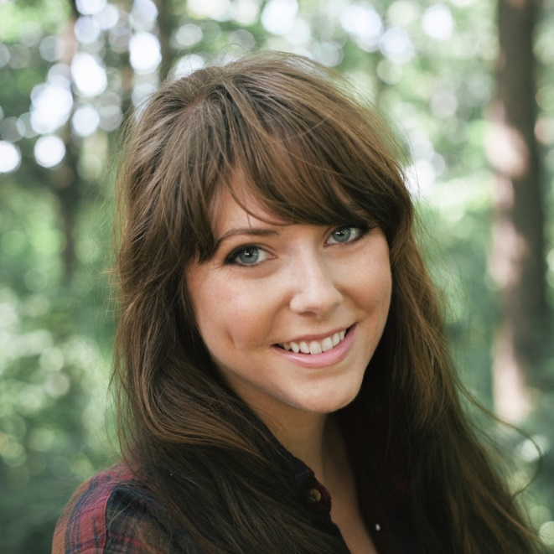
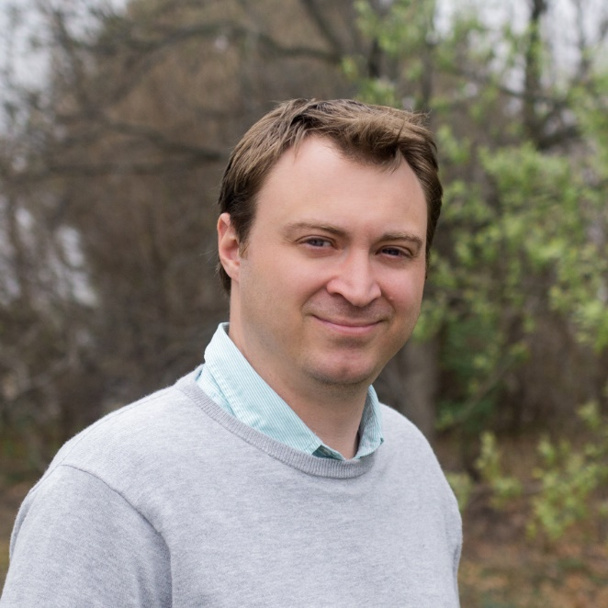
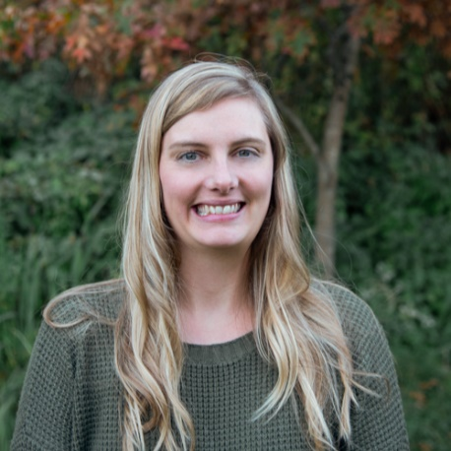
Our Staff
Clare Lindahl CEO
Courtney Allen Event and Professional Development Director/Assistant to the CEO
Annie Binder Director of Publications/Editor
Erika Crady Membership and Chapter Coordinator
Jody Thompson Editorial Assistant
Joe Otto Special Projects and Partnerships Director/Historian
Emily Yaddoff Communications Coordinator
Renee Bouldin Chapter and Community Builder

Slide 5
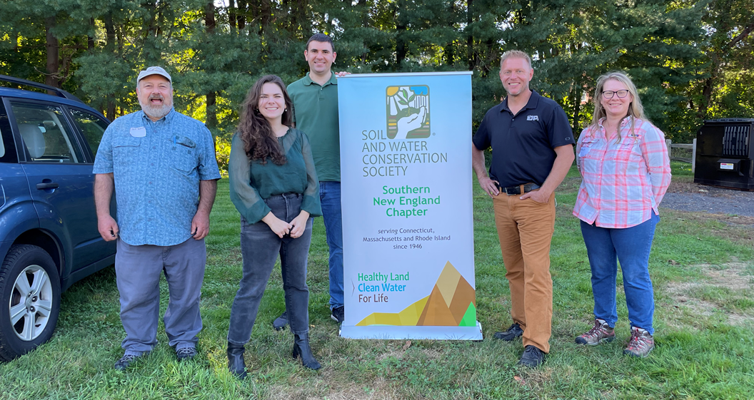
Renee's Chapter Experience

Slide 6
Renee's Chapter Experience

Slide 7
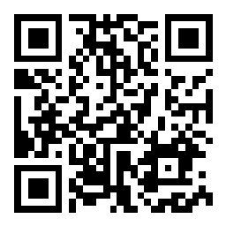
Pre-Presentation Poll
1. In one word, why are YOU an SWCS member?
2. On a scale of 1-5, as a chapter leader, how comfortable do you feel recruiting new members?
1
2
3
4
5
Least
Comfortable
Most
Comfortable
Notes:
Before we get into the meat of this presentation…
https://wall.sli.do/event/44RTVUbpjshME1Zw1B2Z3T?section=fbaba460-14fd-4b6e-963e-b715bacad9ab

Slide 8
Training Agenda
Introductions and Goals
Organizational Development Project
The Latest Tools for Chapter Leaders
Top Five Reasons NOT to Join SWCS
Breakout Room Discussion
Regroup and Final Remarks

Slide 9
#SWCSGOALS
Double and Diversify SWCS membership in the next 2 years!

Slide 10
Why?
Because…
SWCS was formed for a reason—to meet a need—and that need still exists today. It is up to us to meet it.
Together we can have a stronger voice. The more people, the greater diversity of disciplines, experiences, and voices, the better for SWCS, conservation professionals, and our natural resources.
It is one of the tops things we hear chapter leaders want.
I know the benefits of the network personally.
I believe it is healthy for us to be connected, professionally and personally.

Slide 11
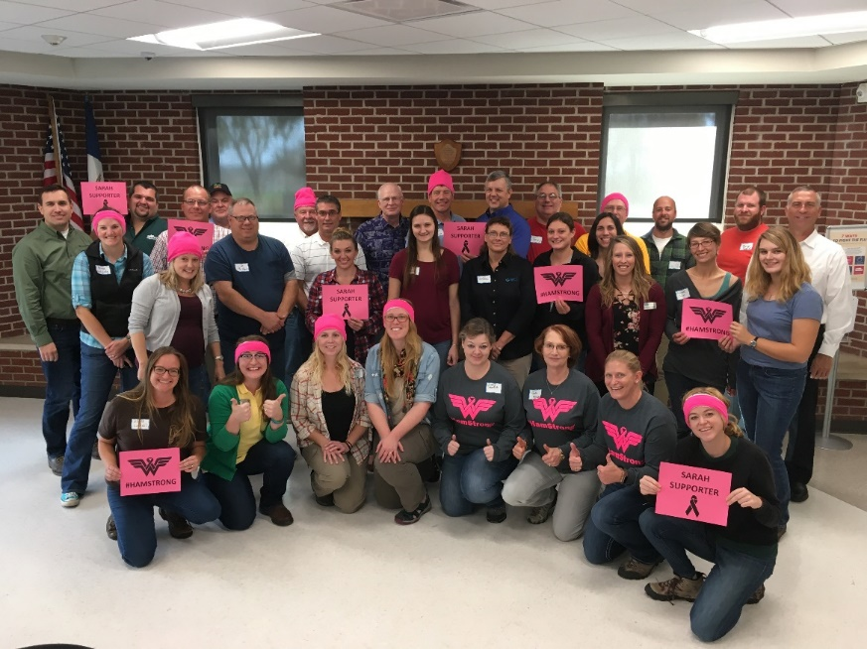
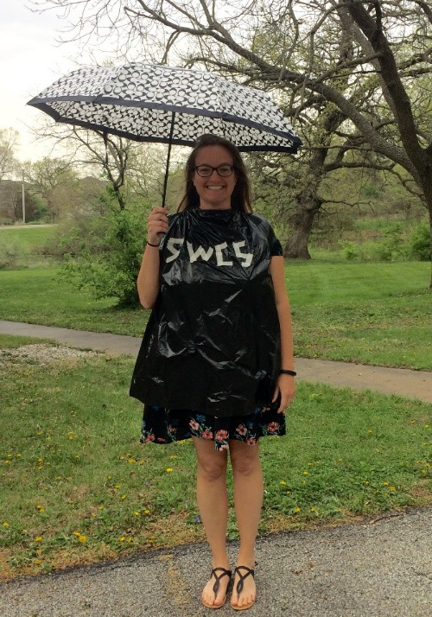
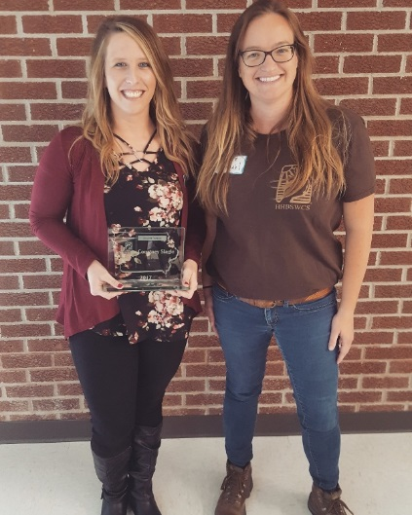
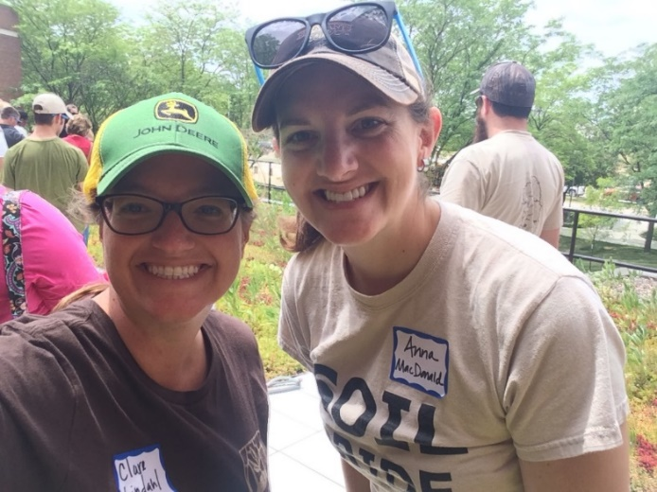
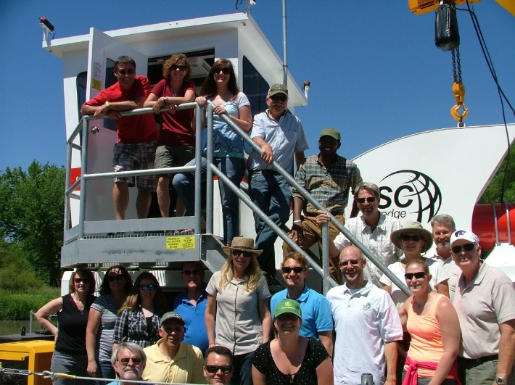
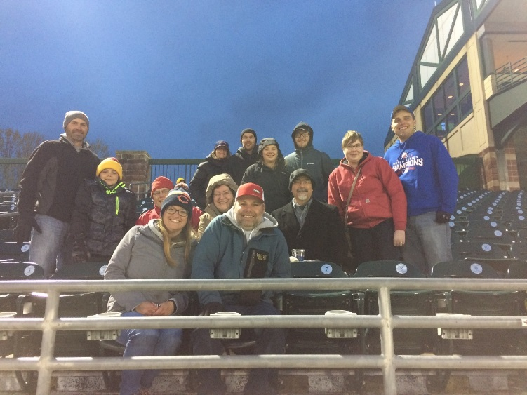
My Chapter Experience
4th year as CEO
10th year of membership with the Society
4th year in the President’s Club
6th year as a chapter leader: Incoming President (2016), President (2017), Past President (2018), and Membership Chair (2019-present)

Slide 12
SWCS Strategic Organizational Development Plan
From January to July, 2021, SWCS crafted a three-year strategic organizational development plan for evolution of the organization
Solicited, evaluated, and selected a consultant, Delta Think
Met every other week
Oversaw market analysis, distribution of a survey, and in-depth interviews
Developed recommendations for membership, local chapters, and the Journal of Soil and Water Conservation driven by this data

Slide 13
The Value of Chapters
SWCS membership satisfaction is reliant on the chapter experience
If the chapter is active, so are the members and vice versa
27% of members rarely or never interact with their chapter; 57% of members did not volunteer with SWCS
Members want chapters to continue, and 59% of member survey respondents <30 would like to engage more with their local chapter – this bodes well for the future
Chapter offerings members find most important include:
Networking events and tours
Training and professional development
Youth involvement and recruitment
Access to local farmers and producers
Learnings from the Strategic Organizational Development Plan

Slide 14
The Need for Communication, Clarity, Updates, and Capacity
Current member categories/benefits are not well-defined or articulated; members/potential members don’t “see” themselves in the available options
24% to 33% of survey respondents were simply unaware of current SWCS offerings
Outdated systems in need of investment
Lack of capacity internally to serve chapters and communicate to members
Learnings from the Strategic Organizational Development Plan

Slide 15
The Need to Communicate
Members feel an emotional commitment to the SWCS mission: the survey showed that most join (50%) and stay members (55%) to support the mission
Members are mainly influenced to join by a mentor or colleague
Also high on the list of why people join was networking, professional development, and to be part of the SWCS community (professional development dropped when it came to why people renewed)
32% somewhat or strongly disagree that SWCS membership is important to career advancement
Better promotion of SWCS impact on conservation
More communication of benefits
Learnings from the Strategic Organizational Development Plan

Slide 16
Interest in New Services
There was an interest in the following:
Connect to farmers
Multimedia library of conservation content
Access to soil and water testing kits for purchase in the field
Interpretation of journal articles through short video interviews with authors
Conservation certificate program
Conservation speakers bureau
Mentoring
Small group discussion among peers
Easily accessible peer directory
Learnings from the Strategic Organizational Development Plan

Slide 17
Topics of Interest
Most desired topics of interest include the following:
Technical conservation topics and market trends
Social science
Outreach and communication in conservation
How to/interactive videos
Training on research
Science and communication
Youth conservation education
Learnings from the Strategic Organizational Development Plan

Slide 18
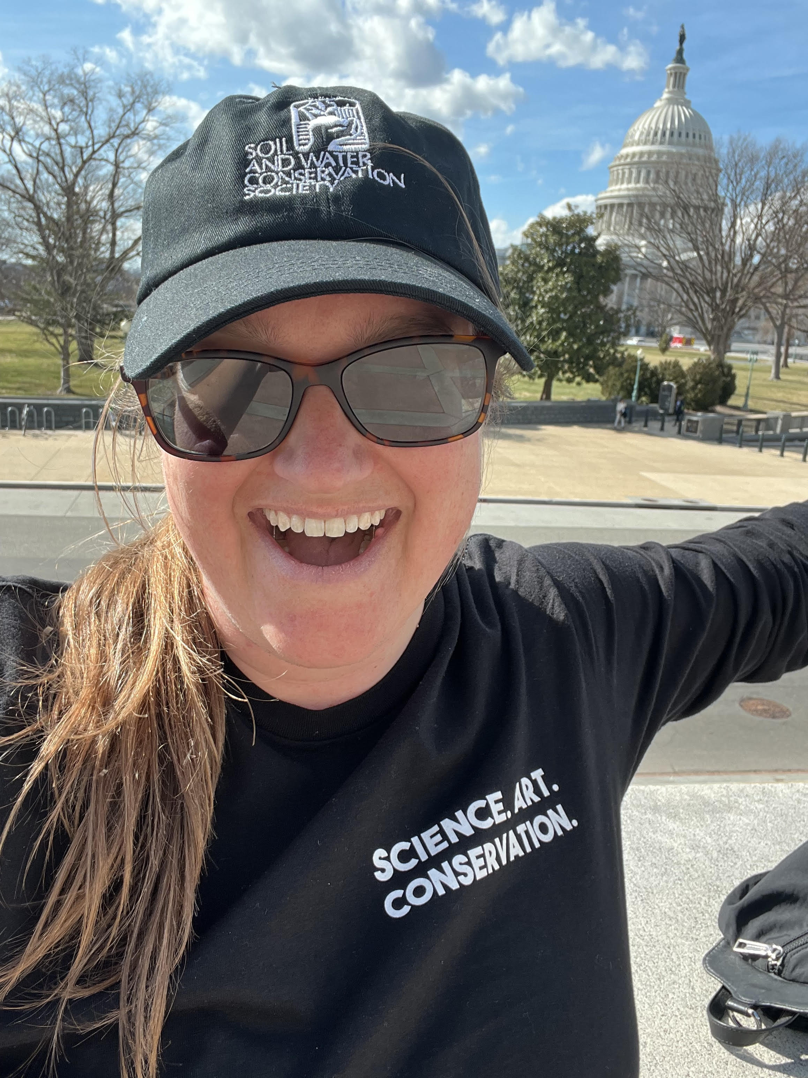
Policy and Trends
58% valued being informed of relevant policy and trends
Translating SWCS priorities and member needs and ideas into advocacy and policy
Twitter: @Clare4soilnH20
Learnings from the Strategic Organizational Development Plan

Slide 19
First Steps in Implementation
Added capacity by bringing on a dedicated Chapter and Community Builder, Renee Bouldin, and a Communications Coordinator, Emily Yaddoff
Aggressively implementing the recommendations of the strategic organizational development plan
Emily Yaddoff
Communications Coordinator
Renee Bouldin
Chapter and Community Builder
Implementing the Strategic Organizational Development Plan

Slide 20
Erika Crady
Joined the SWCS team June 2016
Membership Director
Why I love my job!
I’m here to help!
Moving forward, leadership, and focus

Slide 21
Membership Goals
Define who is a conservation professional and member, put front and center on EVERYTHING, and make JOIN front and center of website homepage
Revamp membership categories so members see themselves; add a retiree option and identify a role for them (We hear you!)
Use a membership database that makes joining, renewing, and engaging easier for members, and makes administration and communication to members easier internally
Adjust/enhance benefits to ensure value for members versus community at large by adding 3 new membership services/benefits per year
Conduct 3 member touches each month, consider how to bring positivity, fun, and joy
Conduct 3 recruitment and renewal strategies each month
Consider membership across all departments, particularly communication
Develop chapters and their leaders to recruit and renew members and add value to membership locally
Implementing the Strategic Organizational Development Plan

Slide 22
Chapters Goals
Implement a vision in which member engagement is national AND chapters, not national OR chapters, where we are working together and supporting one another
Regular training and tool offerings based on your needs
Opportunities for dialogue between chapters and headquarters and between chapters
National and chapter collaborations on events, grants, and sponsorships (highest ranked area of interest from chapter leaders)
Craft, with chapter leaders, standards for chapter function and activity, and identify the support and resources needed to meet those standards
Implementing the Strategic Organizational Development Plan
Notes:
This is the big picture vision. This training is just a starting point

Slide 23
Goals for Today
Distribute new tools for chapter leaders
Help our leaders feel more comfortable making the membership ask
Start conversations between chapter leaders

Slide 24
Overarching Goal: Make Membership Personal

Slide 25
Tools for Chapter Leaders
www.swcs.org/chaptertools

Slide 26
Our Updated Webpage!
www.swcs.org/chaptertools

Slide 27
About chapters, starting a chapter, joining chapter leadership, tax information, organizational tools
Webinar recordings and resources
Membership materials, recruitment tools (infographics and flyers), member retention (scripts)
Building a chapter website, design resources, graphics for websites and social media
Event calendar, chapter event submission form, event resources (swag ideas, offering CEUs)
Chapter reports and chapter awards nominations

Slide 28
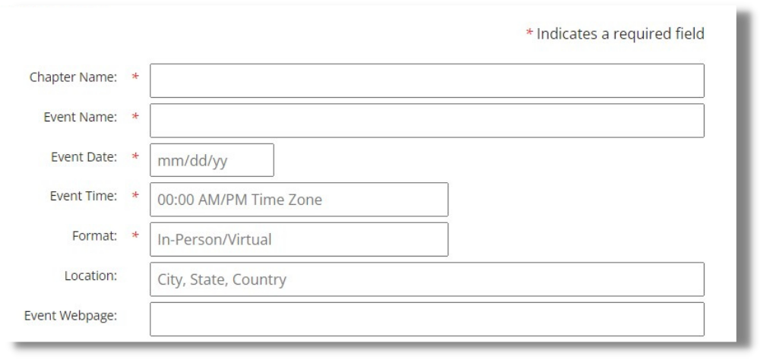
Chapter Event Submission Form
Please use this form to submit your events for inclusion in:
The Conservogram
Our events calendar
SWCS social media

Slide 29
92% of chapter leaders highlighted member recruitment as a priority for national to assist with in their 2020 Chapter Reports.

Slide 30
We've broken these recruitment materials into 4 categories:
1
General Member Recruitment
3
Chapter Leadership Recruitment
2
4
Student and Early Career Professionals Recruitment
NRCS Recruitment

Slide 31
General Recruitment
1
Who?
Why?
How?
Use these tools to recruit new members and retain those who may not be getting the full value of their membership.
Membership numbers have been declining. We need to increase our numbers to meet our goals!
Add the infographic and flyer to your websites. The graphic can be used on social media or in presentations.

Slide 33
NRCS Recruitment
2
Who?
Why?
How?
Use these tools to recruit NRCS employees and other conservation practitioners.
Many NRCS employees no longer receive information about SWCS and don't know what we do. Let them know we're working for them.
Add the infographic and flyer to your websites. The graphic can also be used on social media. Send the flyer to listservs for NRCS employees.

Slide 35
Chapter Leadership Recruitment
3
Use these tools to recruit new Board members or other volunteers to assist with chapter work.
Who?
Why?
How?
Show the professional and personal benefits of getting more involved in their local chapter.
Add the infographic and flyer to your websites. The graphic can be also be used on social media. Distribute this information when releasing call for nominations or making the direct ask for volunteers.

Slide 37
Student and Early Career Professional Recruitment
4
Use these tools to recruit new student members and those just starting their careers as conservation professionals.
Who?
Why?
How?
Show the value of membership to folks who could use resume-building experiences and networking opportunities.
Add the infographic and flyer to your websites. The graphic can be used on social media or in presentations at universities. Distribute to student chapters in your region or use this information to help jump-start student chapters.

Slide 39
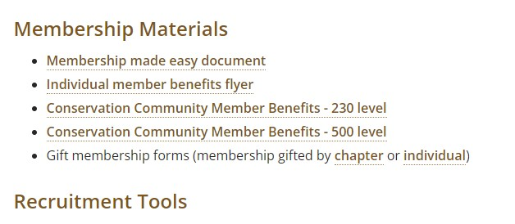
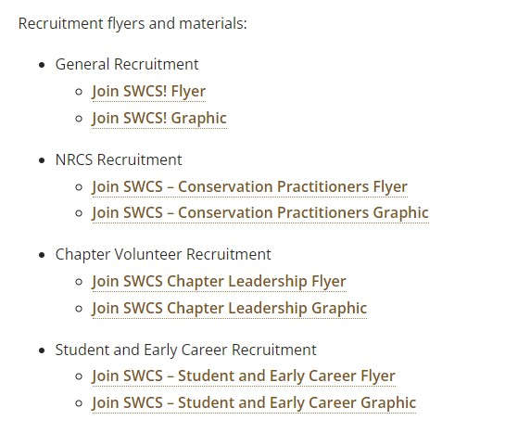
New flyers and graphics here!

Slide 40
New Facebook Group

Slide 41
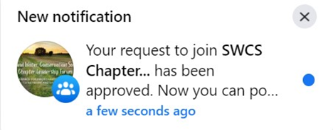
How to Join
www.facebook.com/groups/swcschapterleadershipforum
Once a SWCS staff member accepts your request, you will receive an approval notification

Slide 42
Example Posts
Advice requests
Chapter events
Upcoming events and actions
Requests for collaboration
Recaps with advice
Newsletters
Opportunities for members
Recruitment strategies
Management tools
What tools has your chapter used that work for you?
Budget examples
Tax information
Chapter website and social media management

Slide 43
Share Your SWCS Experience!

Slide 44
Create a Flipgrid Video
The Goal: Create a member recruitment video by taking quick clips of your stories and stitching them together. For use at events, on social media, and more!
In the Meantime: Share your experience with other chapter leaders. View and comment on videos about what’s inspired you. Use these stories in your recruitment pitches.

Slide 45
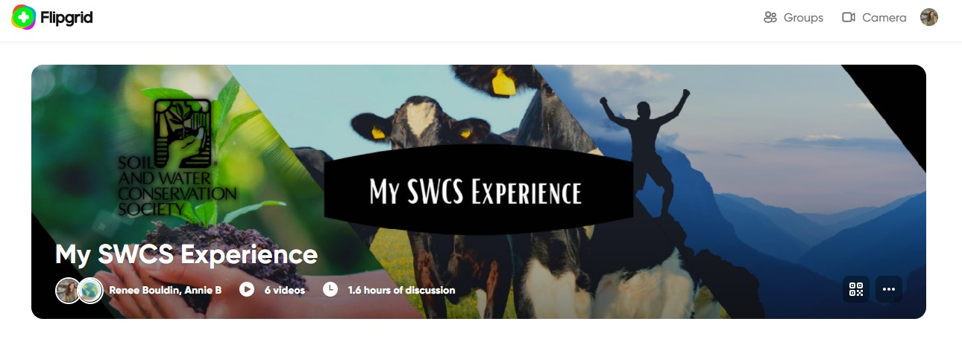
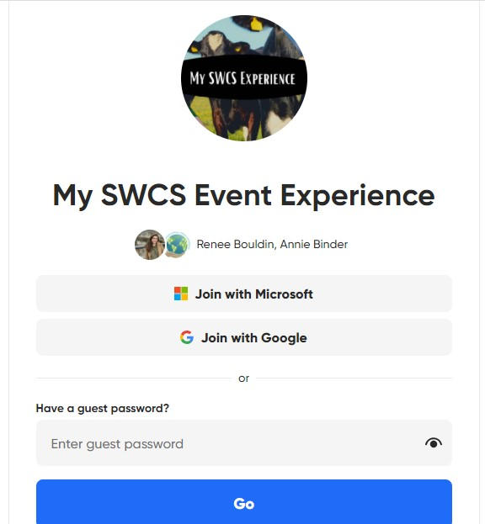

Slide 46
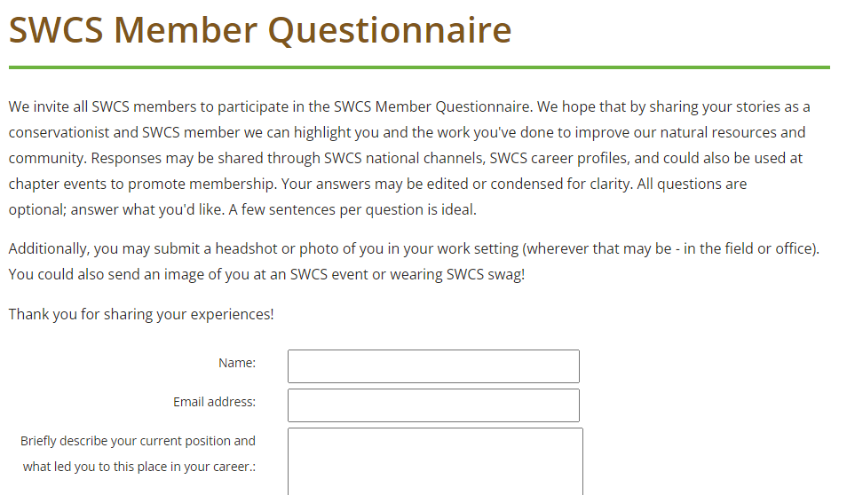
Fill out the Membership Questionnaire
The Goal: Create interesting graphics for social media and presentations with your quotes and images to share your stories with potential members.
In the Meantime: Use these questions to jump-start your storytelling!
Notes:
5 minutes max, quick responses are best, and share images!
Thank you to those who have already participated!

Slide 47
Top 5 Reasons NOT to Join SWCS
Turn the negatives into positives!

Slide 48
It's too expensive!
1
Your Experience:
Available Tools:
Why do you pay?
Employer? Value of benefits? Journal?
What have you gotten out of membership?
At your chapter level and national level?
$115/year = less than $10/month
General Recruitment Flyer and Infographic
Membership Made Easy
Individual Member Benefits Flyer
Gift Membership Forms
Conservation Community Memberships

Slide 49
I don't have time!
2
Your Experience:
Available Tools:
What is your time commitment? Why is that worthwhile for you?
Easy ways to get involved with the chapter that aren’t as time-consuming. Event volunteer? Projects?
Professional certifications and value of trainings
Chapter Leadership Flyer and Infographic
Which Professionals Need CEUs?
Chapter Bylaw Review Guidance
Reimagining your Chapter Webinar
Facebook Forum

Slide 50
My employer doesn’t give me incentives to participate.
3
Your Experience:
Available Tools:
Does your employer pay for your membership? If yes, why? If not, why is membership worthwhile to you out of pocket?
Value of professional development and networking
Office-wide memberships
“I know I'm a better employee for participating, networking, and being broader minded.” – SWCS Member
General Recruitment Flyer and Infographic
NRCS Recruitment Flyer and Infographic
Conservation Community Memberships

Slide 51
I’m already a member of *another professional society*
4
Your Experience:
Available Tools:
Why did you choose to be a member of SWCS? What makes us different?
Diversity of careers and membership
Value to students and early career professionals
Special projects
General Recruitment Flyer and Infographic
Student and Early Career Professionals Flyer and Infographic
NRCS Flyer and Infographic
Guide for Students and Early Career Professionals in Conservation

Slide 52
I'm Retired.
5
Your Experience:
Available Tools:
Who do you know who is involved and retired? Why are they involved? Start those conversations!
Mentoring opportunities and giving back to the mission
Low commitment volunteering options
Facebook Leadership Forum
General Recruitment Flyer and Infographic
Events Calendar
23% of lapsed members haven’t renewed because they are retired

Slide 53
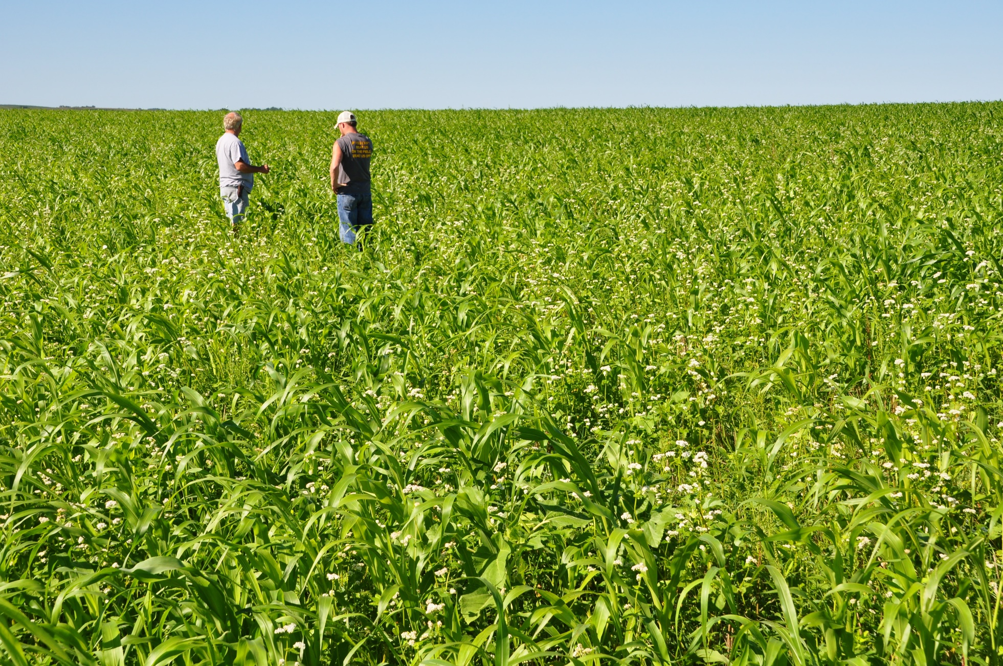
What’s Next?
How do we recruit on a larger scale?
What value does being a member of your chapter add?
How can we delineate those member benefits?
NRCS/SWCS photo by Lynn Betts

Slide 54
Breakout Room Discussion
1. How do we make large-scale member asks? Ideas for recruitment drives?
2. When was the last time you successfully recruited a member or a new group of members?
Notes:
Introduce staff, video request on

Slide 55
Breakout Room Discussion

Slide 56
Breakout Room Regroup
1. How do we make large-scale member asks? Ideas for recruitment drives?
2. When was the last time you successfully recruited a member or a new group of members?

Slide 57
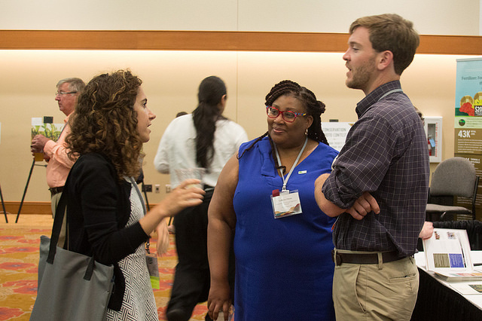
Leave a Legacy
Our responsibility to recruit those next leaders
We have to make the ask

Slide 58
Post-Presentation Poll
On a scale of 1-5, as a chapter leader, how comfortable do you feel recruiting new members?
1
2
3
4
5
Least
Comfortable
Most
Comfortable

Slide 59
Upcoming Dates - 2022
March 4
April 14
July 31 -
August 3
August 30 -
September 2
Chapter Reports Due // Intern Applications Due
Awards and Scholarship Applications Due
77th SWCS International Annual Conference
Denver, Colorado
International Drainage Symposium
Des Moines, Iowa

Slide 60
Please take the post-event survey!

Slide 61
Next Steps:
Take the survey
Join the Facebook Group
Record a Flipgrid video
Fill out the questionnaire
Review the website and list of tools (event submission)
Add these infographics and flyers to your website and social media

Slide 62
Thank you for joining us!

