Slide 1
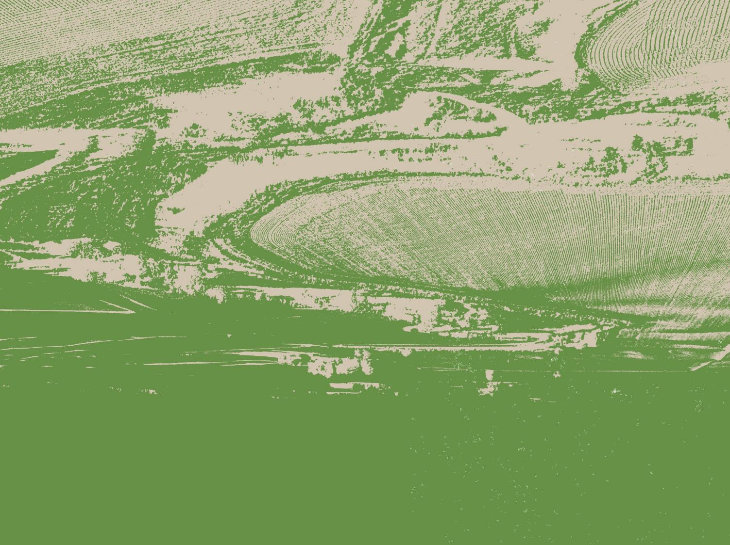
Saturated Buffer

Slide 2
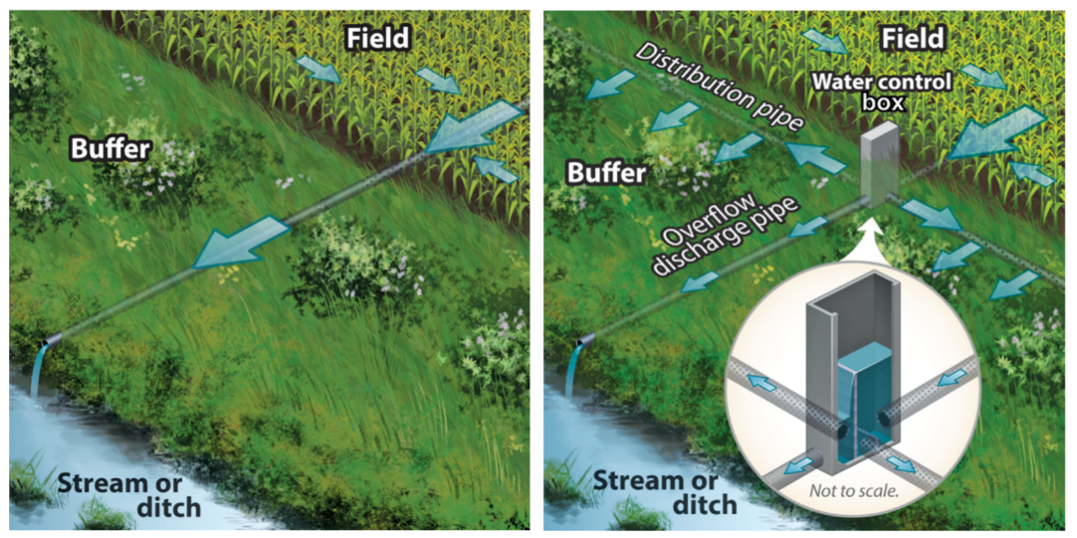
What Is a Saturated Buffer?
A saturated buffer is an area of perennial vegetation between agricultural fields and waterways where tile outlets drain.
Conventional Tile Outlet Tile Outlet with Saturated Buffer
Illustrations credit: Frankenburger et al., Unpublished

Slide 3
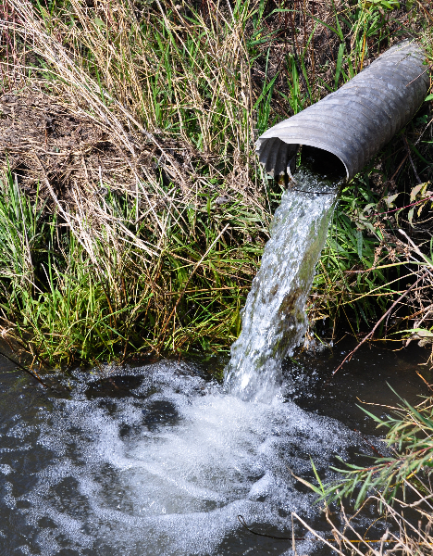
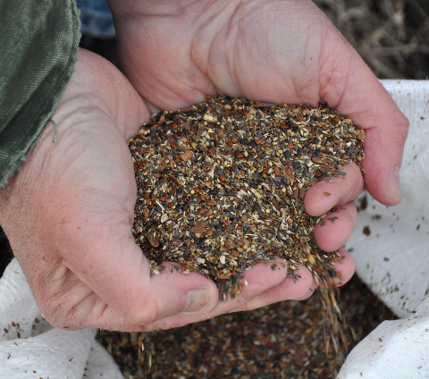
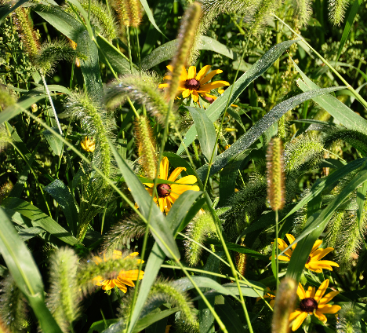
Why Use a Saturated Buffer?
Tile lines connect to a control structure, which distributes water laterally along the buffer.
As water drains into the buffer, the living roots of perennial vegetation absorb water and nutrients, like nitrate-nitrogen.
NRCS/SWCS photos by Lynn Betts.

Slide 4
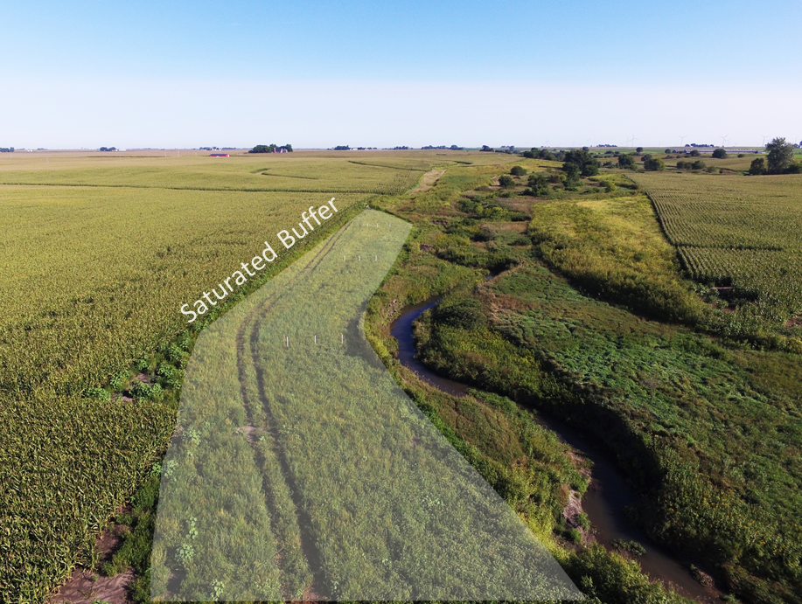
What Can a Saturated Buffer Do for Water Quality?
According to the Iowa Nutrient Reduction Strategy, a saturated buffer has the potential to remove 50% of nitrate-nitrogen from water that is diverted through the buffer.
Saturated buffer in Story County, Iowa. Prairie planting is in its first year of growth. NRCS/SWCS photo by Lynn Betts.

Slide 5
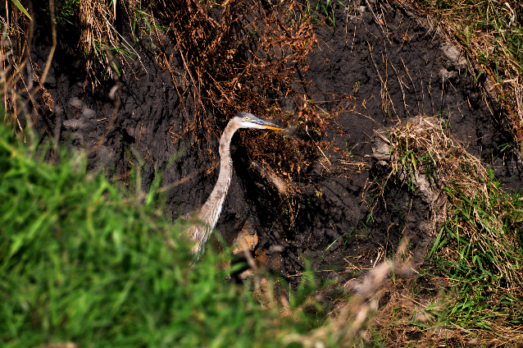
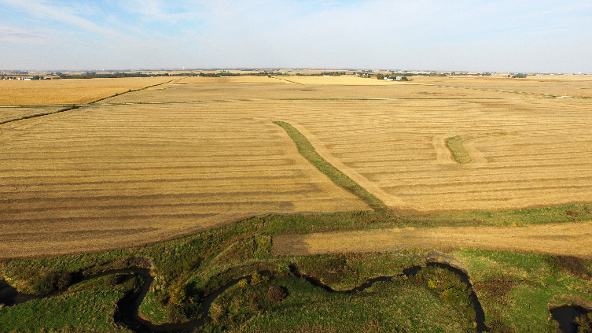
Benefits of a Saturated Buffer
Decreases nitrate-nitrogen being deposited in waterways
Decreases turbidity and volume of water in waterways
Stabilizes stream banks
Provides wildlife habitat
NRCS/SWCS photos by Lynn Betts.

Slide 6
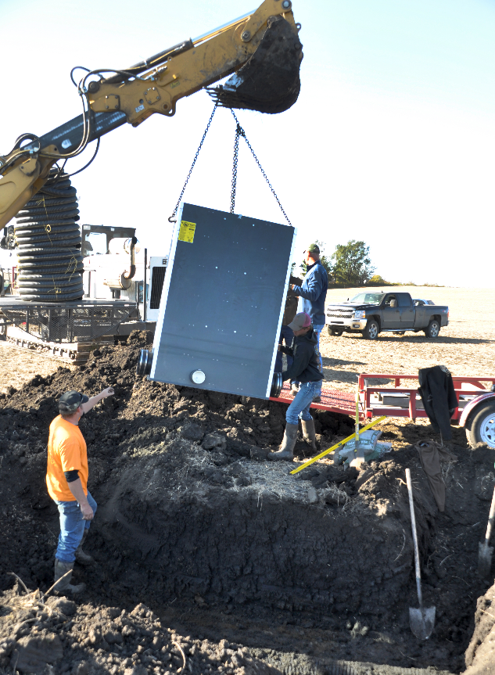
What Is the Cost of a Saturated Buffer?
Cost of installation and equipment to drain a 25 acre area is about $2,000, but varies greatly depending on the landscape.
Compatible with existing federal (such as the NRCS’s EQIP funds) and state cost-share programs so farmers who implement them can recoup some of their costs.
NRCS/SWCS photo by Lynn Betts.
Installation of water control structure in Story County, Iowa.

Slide 7
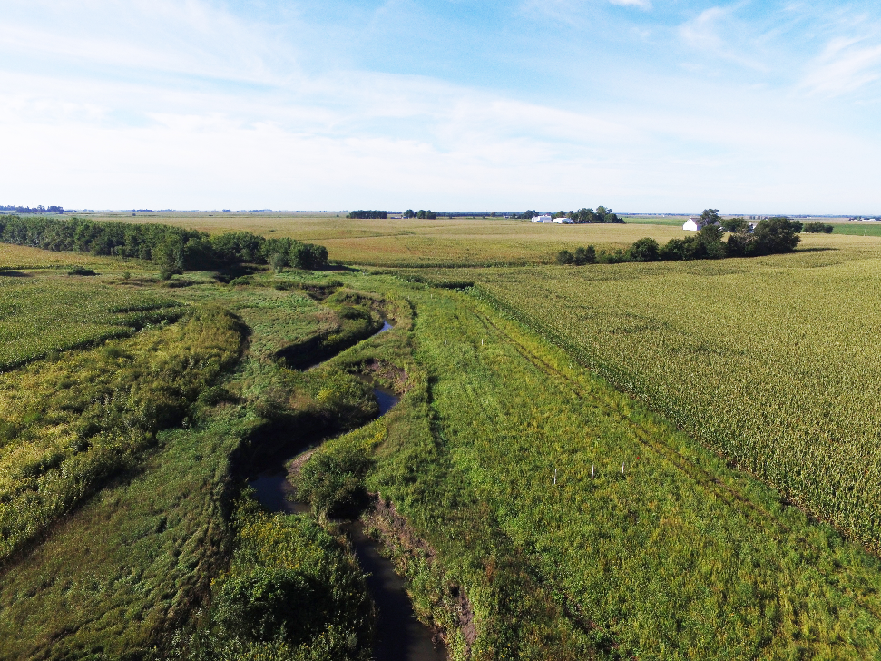
Saturated Buffers Work Best when…
Soil along the buffer is high in organic matter and low in sand or gravel.
NRCS/SWCS photo by Lynn Betts.

Slide 8
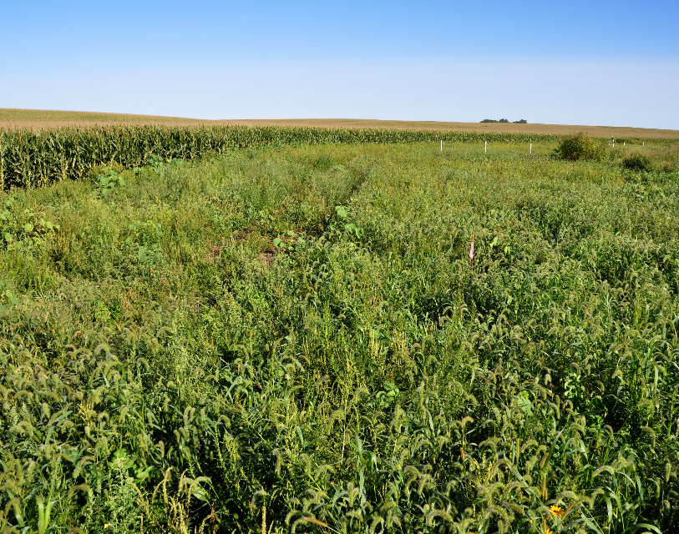
Saturated Buffers Work Best when…
The buffer should be:
At least 30 ft wide
At least 300 ft long
Relatively flat
Maximum elevation change of 2 ft
> 30 ft.
> 300 ft.
First-year growth of prairie plants in saturated buffer in Story County, Iowa. NRCS/SWCS photo by Lynn Betts.

Slide 9
Other Resources
https://www.flickr.com/photos/151012306@N08/albums/72157696778831671: A step by step visual guide to saturated buffer implementation. These photos were taken on real farms across Iowa and are part of the Conservation Media Library.
https://vimeo.com/291573566: A video about saturated buffer implementation in Iowa that is part of the Conservation Media Library.
https://transformingdrainage.org/practices/saturated-buffers/: A storing house for saturated buffers research from a collaborative research group across eight states.
https://store.extension.iastate.edu/product/14441: Two-page factsheet on saturated buffers from Iowa State University Extension.
http://www.saturatedbufferstrips.com/: A research collaboration between the Agricultural Drainage Management Coalition (a coalition of drainage-affiliated businesses) and the National Laboratory for Agriculture and the Environment (USDA Agricultural Research Service).
https://www.iowalearningfarms.org/page/webinars: On April 18, 2018 Dan Jaynes with USDA-ARS gave a webinar on saturated buffers for Iowa Learning Farms.

Slide 10
This presentation is part of the Conservation Media Library. To learn more about it and access other resources, go to www.swcs.org. The Library was supported by an Iowa NRCS funded Conservation Innovation Grant to the Soil and Water Conservation Society and Conservation Districts of Iowa.

